Slide 1
Bank Fraud detection

Slide 2
Data Description
Data- https://www.kaggle.com/turkayavci/fraud-detection-on-bank-payments
Step: This column tells us about the day of the transaction that has been done.Data here is for 180 days.
Customer: This column is the customer id
zipCodeOrigin: The zip code of customer.
Merchant: Merchant's id
zipMerchant: Merchant's zip code.All the merchants are from same zip location.
Age: Age is categorised into six buckets (0 - 6)
0: <= 18,
1: 19-25,
2: 26-35,
3: 36-45,
4: 46:55,
5: 56:65,
6: > 65
U: Unknown
Gender: Gender takes any of the below values
E : Enterprise,
F: Female,
M: Male,
U: Unknown
Category: This column tells about the industry on which shopping is done
Amount: Amount of the purchase
Fraud: This is a flag variable holding only two values.If its fraud transaction value is 1,for non fraud transaction the value is ‘0. All analysis is based on targeting this variable.

Slide 3
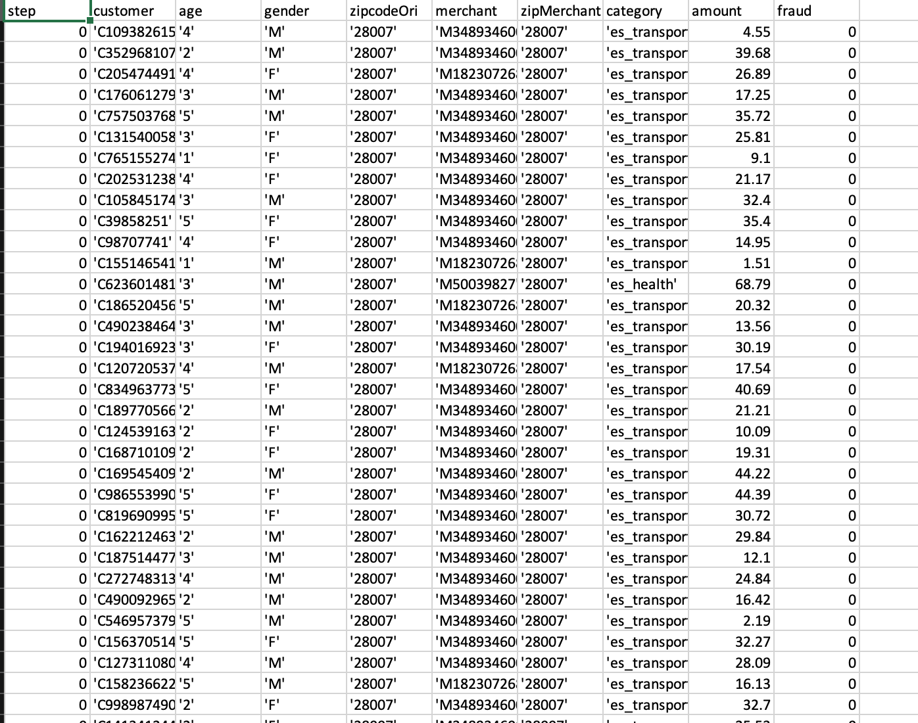
Data at a glance

Slide 4
Number of Frauds
Total number of transactions - 594643
No of fraud transactions - 7200
1.21% of fraud transactions

Slide 5
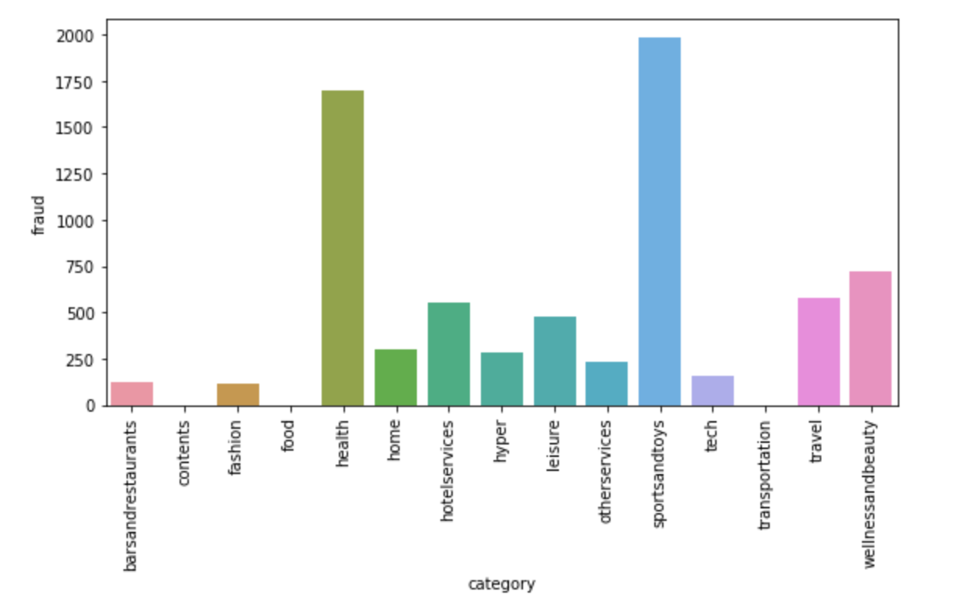
Category split

Slide 6
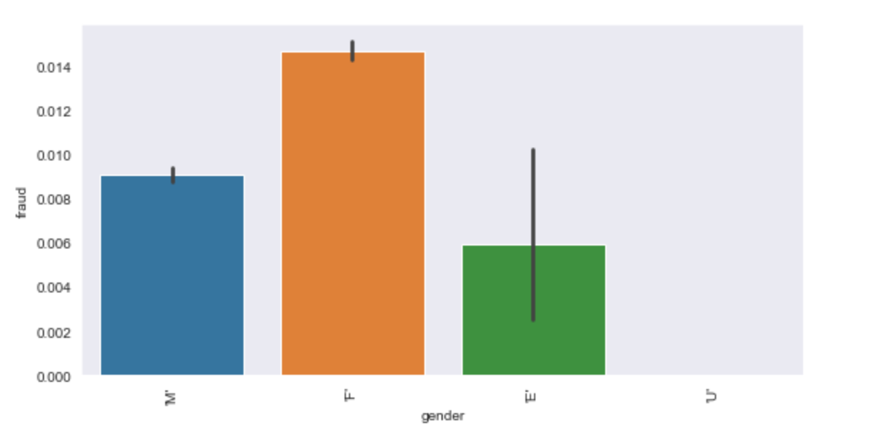
Gender based split for fraud tranactions

Slide 7
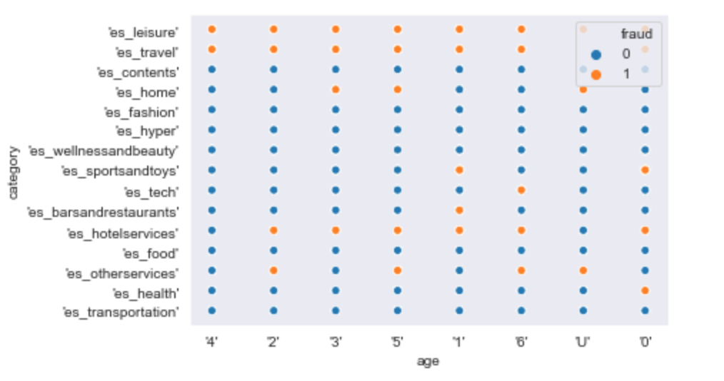
Leisure and Travel had almost fraudulent transactions only
Sportsandtoys has fraud transactions in age group 19 to 25

Slide 8
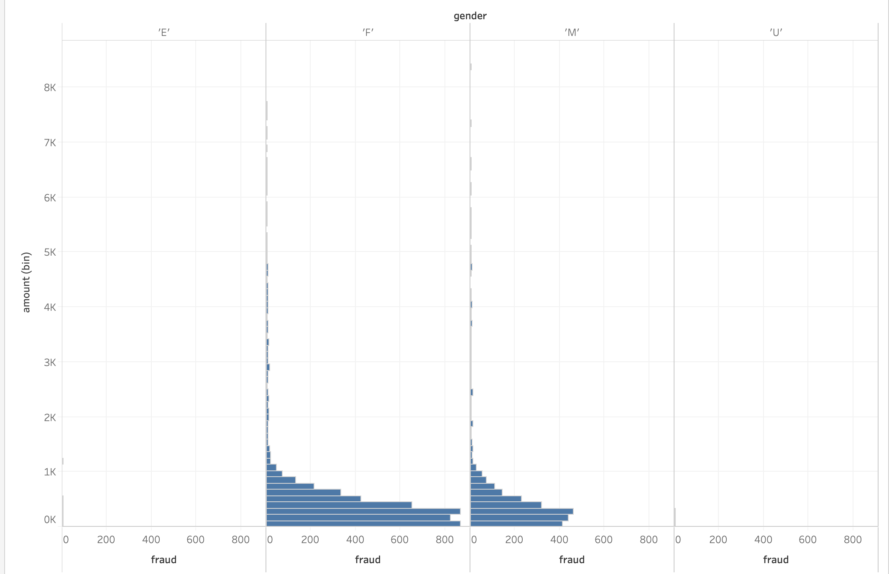
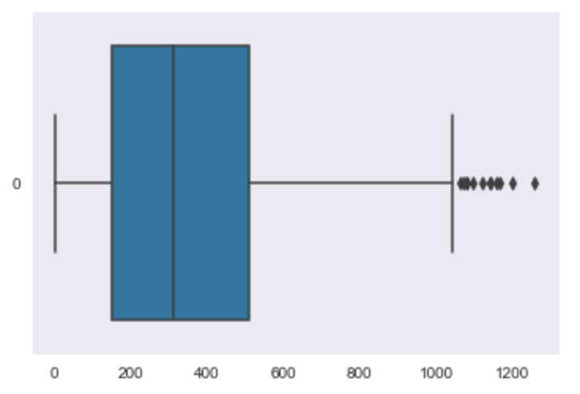
Less amount - More prone to Fraud transactions

Slide 9
Conclusion
In Sports and toys category 98% of the transactions are fraud
Travel and Leisure industry has mostly fraud transactions
Females are the more targeted gender on fraud transactions
Predominant fraud transactions are made on lesser amounts ,amounts <2000

